Slide 1
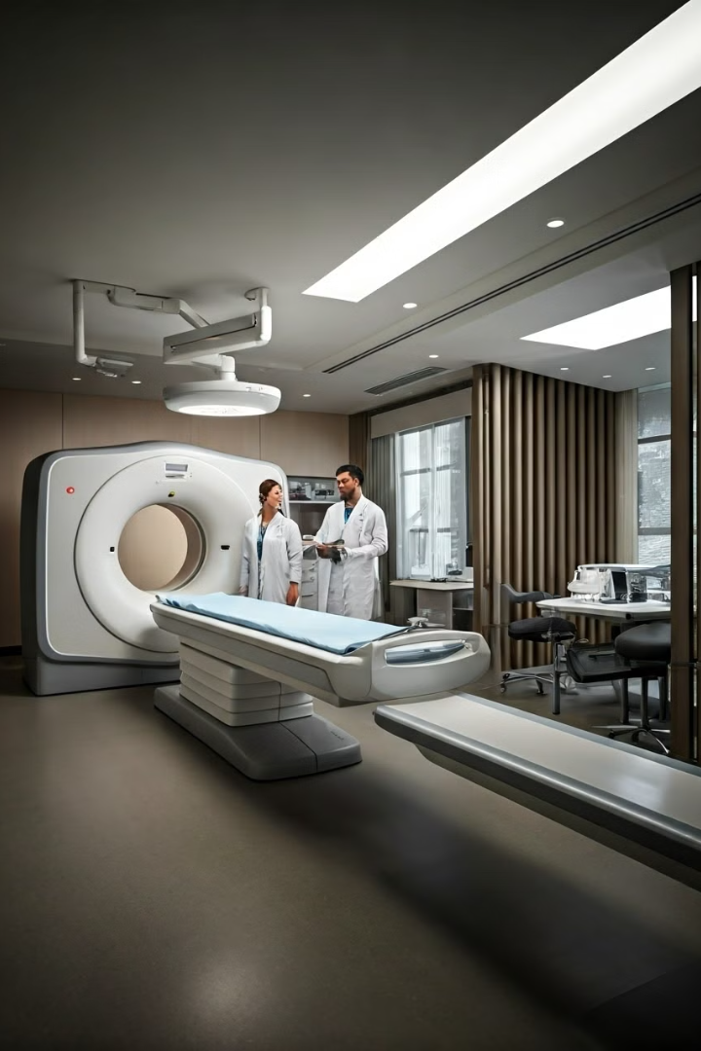
AI-Powered Disease Prediction System
This presentation outlines a revolutionary AI system designed to predict diseases using advanced deep learning techniques. The project aims to revolutionize healthcare access by offering accurate diagnoses and personalized treatment recommendations.
Team: Data Dreamers
Passionate about leveraging the power of AI for positive change.
Committed to developing innovative solutions for real-world challenges.
BM

Slide 2
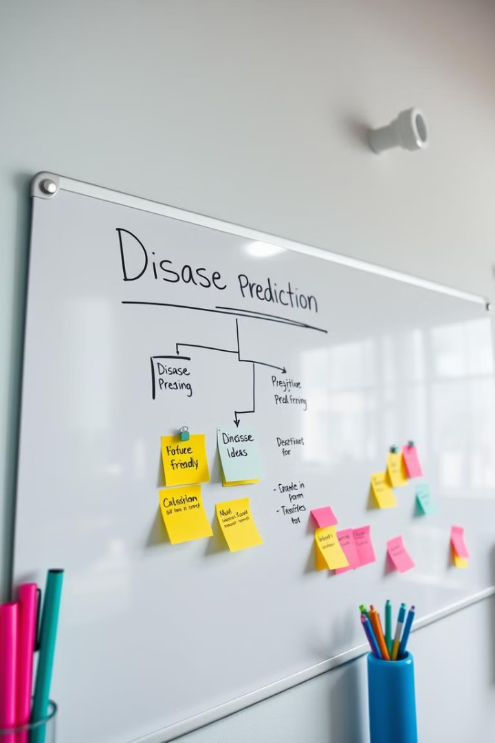
Team Members
M. Baswaraj
K. Sai Pavan
Expertise in machine learning and data analytics and Deep Learning.
Skilled in data integration and software development and interface design and user experience.
L. Vivekadithya
Focus on user interface design and user experience.

Slide 3
Introduction
Problem Statement
Project Objective
Many diseases remain undetected or diagnosed too late due to limited access to diagnostic tools and expertise. This often deprives patients of early intervention opportunities.
Our AI system aims to predict diseases by analyzing medical images and symptoms, ensuring early diagnosis and providing actionable insights for treatment.

Slide 4
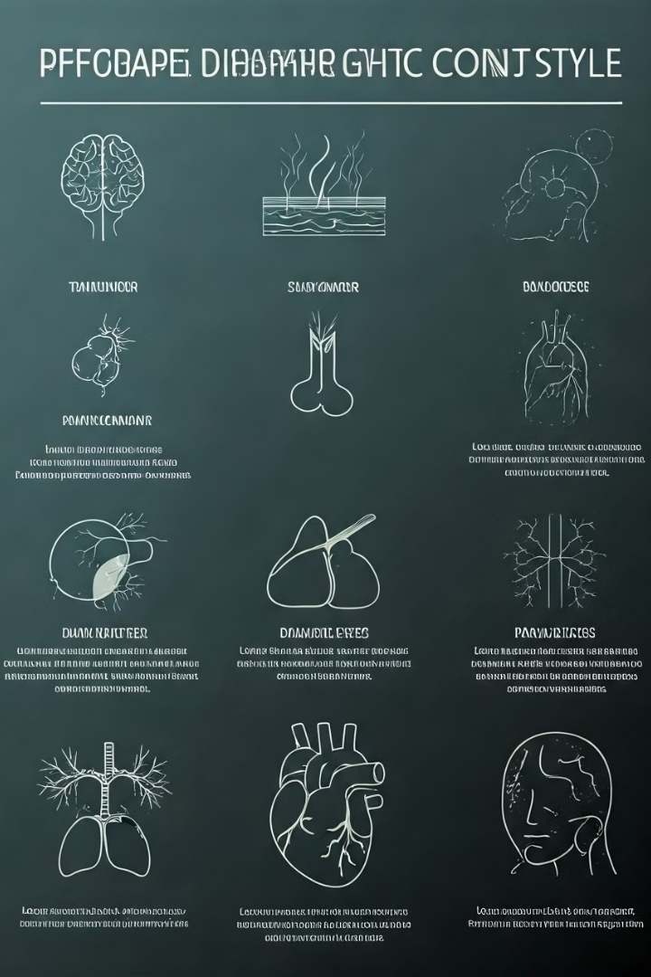
Scope of the Project
Disease Focus
Interactive Chatbot
We focus on diseases like brain tumors, skin cancer, pneumonia, diabetes, heart disease, and Parkinson's disease.
The system includes a chatbot for symptom analysis and hospital recommendations, offering personalized guidance.
Tablet-Alert System
To remind users (patients) to take their medication on time using alerts/notifications.
Real-World Impact
We prioritize accuracy, accessibility, and real-world applicability to bridge healthcare gaps.

Slide 5
Innovation and Creativity
Unique Concept
Inspiration
Our system integrates Convolutional Neural Networks (CNNs), Vision Transformers and Machine Learning Techniques.
Tablet-Alert System To remind users (patients) to take their medication on time using alerts/notifications.
chatbots for multi-modal disease prediction and personalized patient assistance.
The lack of accessible healthcare in rural areas and high mortality rates due to late diagnosis inspired us to leverage AI's potential to bridge healthcare gaps.

Slide 6
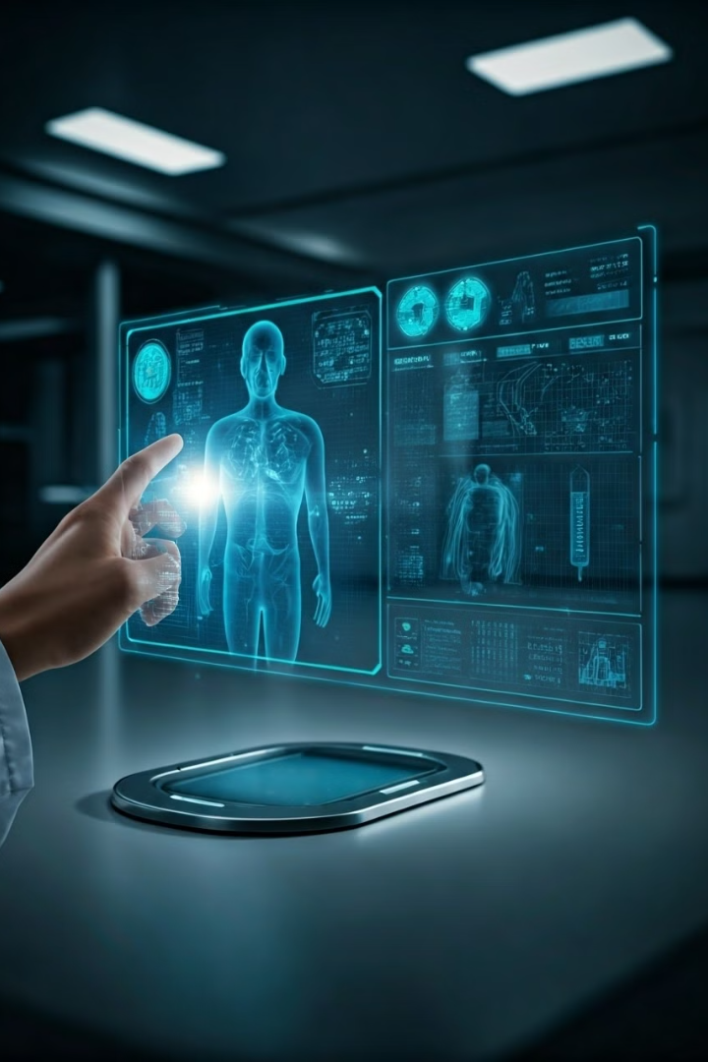
Creative Features
1
Vision Transformer-powered Pneumonia Prediction
2
Symptom-based Chatbot with Geolocation
We utilize Vision Transformers for high-accuracy pneumonia prediction from chest X-ray images.
Our chatbot analyzes symptoms and suggests nearby hospitals using geolocation APIs for personalized guidance.
3
Modular Architecture
The system features a modular architecture that allows for the easy addition of new diseases and updates.

Slide 7
Technical Implementation Overview
Programming Language
Libraries
Cloud Platforms
APIs
TensorFlow, PyTorch, Transformers, Scikit-learn, Pandas, NumPy,matplotlib,
Google Colab, AWS, IBM Watson
Geolocation APIs for hospital suggestions
Python

Slide 8
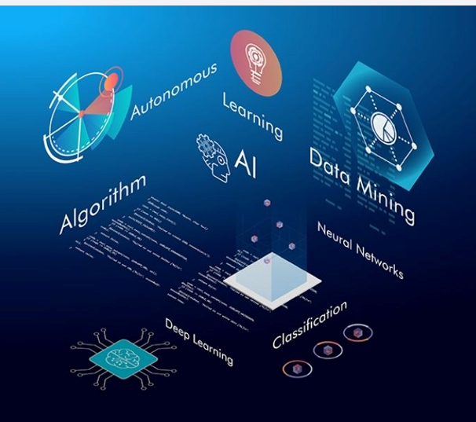
Machine Learning Algorithms:
Random Forest – Heart Disease
CNN – Brain Tumor prdiction.
SVC – Diabetes Values
Decision Tree Classifier – Parkinson

Slide 9
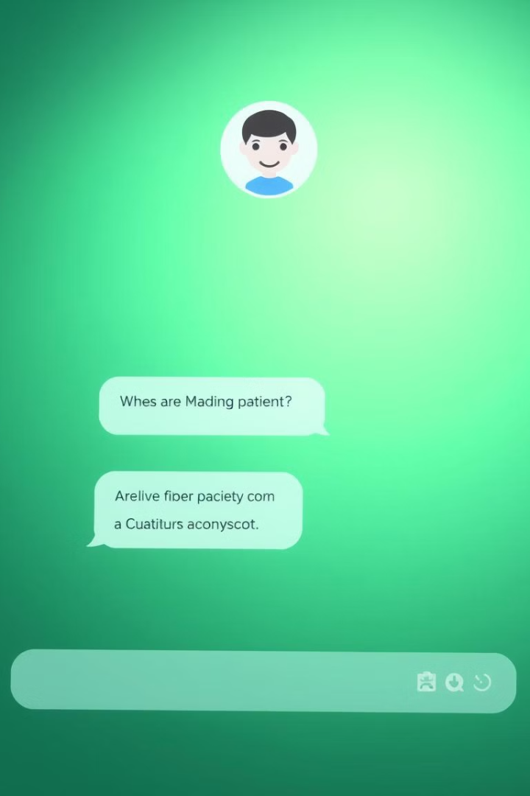
Chatbot for Symptom Assessment and Disease Prediction
Symptom Assessment
Disease Prediction
The chatbot collects patient symptoms and medical history to provide initial insights.
Based on the collected data, the chatbot utilizes machine learning to predict potential diseases.
Hospital Referral
If necessary, the chatbot recommends visiting a healthcare professional and provides information on nearby hospitals.

Slide 10
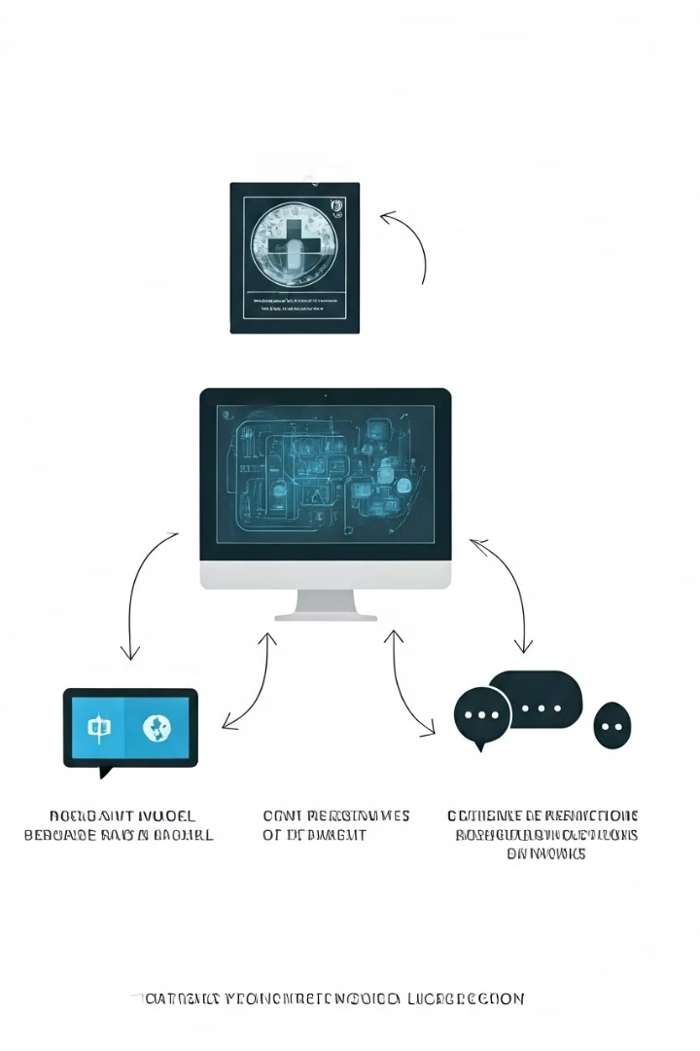
System Architecture
1
Step 1: Medical Image Upload and Values for Classification
Users upload medical images (e.g., brain scans, X-rays), which are processed by CNN and Vision Transformer models and ML Techniques for disease detection.
2
Step 2: Chatbot for Symptom Analysis
The chatbot interacts with users, analyzing symptoms and providing initial guidance. It leverages natural language processing (NLP) to understand user input.
3
Step 3: Combined Predictions and Recommendations
The system combines predictions from image analysis and symptom analysis, offering a comprehensive diagnosis and suggesting nearby hospitals based on the user's location.

Slide 11
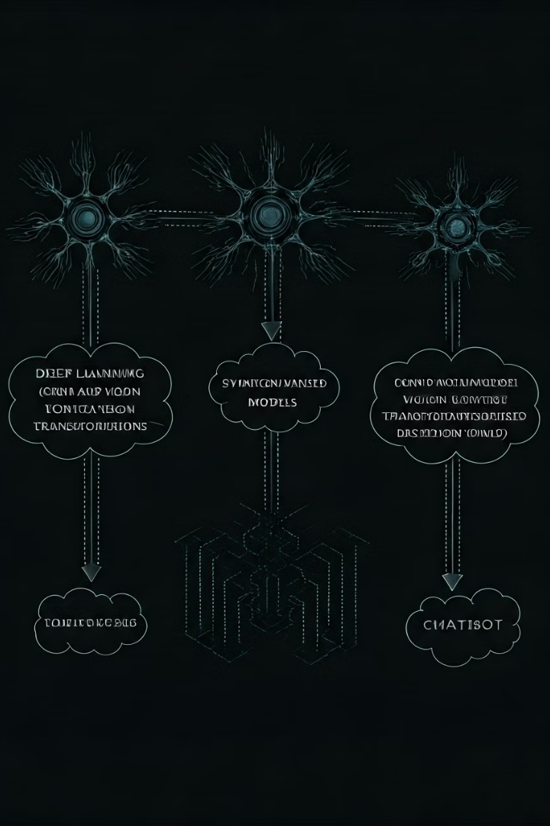




Key Technical Components
Deep Learning Models and ML
Symptom-based Models
CNN and Vision Transformers for image analysis.SVC and Random forest for Classification
Logistic Regression and Random Forest for analyzing symptoms.
Chatbot
Tablet Alert System
Transformer-based NLP for understanding user input.
emergency alerts, public notifications, or internal safety systems.

Slide 12
Challenges and Solutions
1
Challenge: Data Imbalance
Solution: Data Augmentation
2
Techniques like image flipping, rotation, and brightness adjustments were implemented to increase data diversity and mitigate imbalances.
3
Challenge: High Computational Cost
Training Vision Transformers requires substantial computational resources.
Solution: Cloud-based Training on GPUs
4
We leveraged cloud platforms like Google Colab and AWS with GPU acceleration to efficiently train the models.
Code and Architecture Highlights
5
Key parts of the code and architecture, including CNN layers, Transformer architecture, and chatbot workflow, were carefully designed for optimal performance.

Slide 13
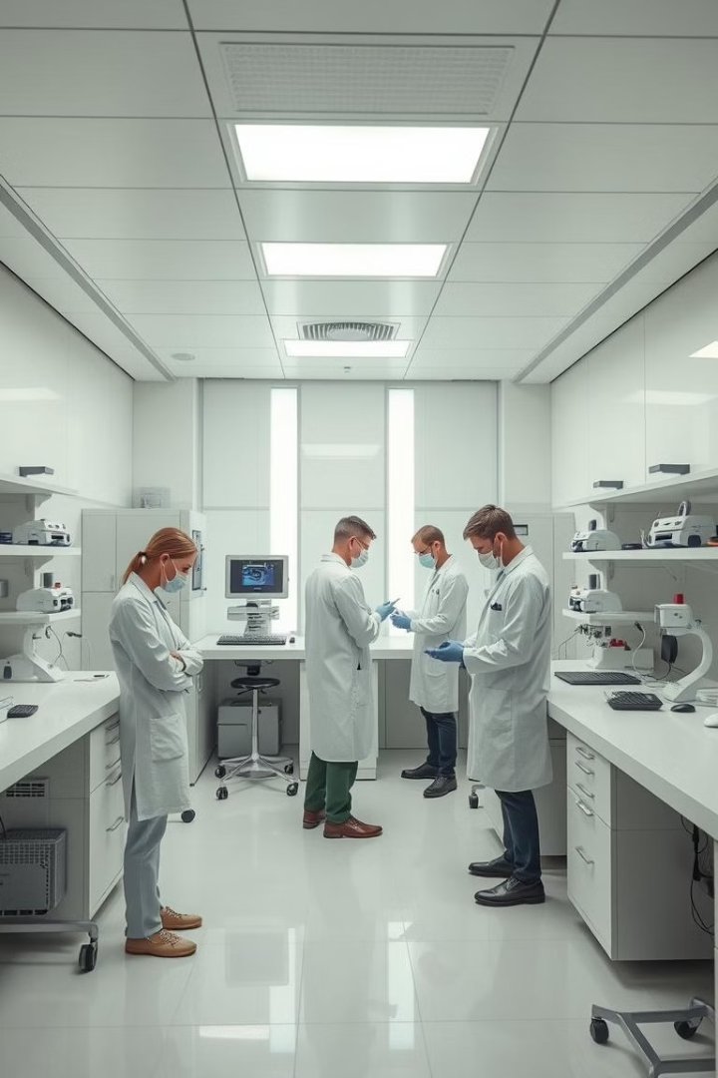
Conclusion and Future Developments
Machine learning holds immense potential to revolutionize healthcare, enabling early disease detection, personalized treatment, and improved patient outcomes. The future holds exciting possibilities for further advancements, including the development of even more sophisticated models, integration with wearable technology, and the creation of AI-powered healthcare assi

